Slide 1

Inventory Tracker
NIE Institute of Technology, Mysuru
Department of Information Science and Engineering
Project by: Rohan S B [4NN18IS040]
Abhishek K [4NN18IS002]
Yadunandan Bhat [4NN18IS057]
Internal Guides: Mr. Sudeep J
Mrs. Shruthi B S

Slide 2
Contents
Brief Project Overview
Project Uniqueness
Project Analysis
System Requirements
Literature Survey
Sequence Diagram
Use Case Diagram
Activity Diagram
Output Model
Future Enhancement
Conclusion

Slide 3
Brief Project Overview
The inventory management ensures that the company always has the required materials and products in hand while keeping the cost as low as possible.
Inventory Management refers to the process of supervising and controlling the stock items of a company.
Typically, Inventory Management Systems are used by firms that either sell a product or manufacture a product for the purpose of accounting all the tangible goods that allow for a sale of a finished product, or parts for making a product.

Slide 4
Project Uniqueness
Easy and intuitive to use.
Our project helps in organizing and maintaining data with well designed file structures and by eliminating the legacy methods of maintaining data in physical files.
No maintenance required (Overhead of maintaining all the data in physical files can be eliminated).
Program takes less space on the harddisk.

Slide 5
Project Analysis
We have used Document Processing and Indexing in this project.
Document Processing is used to collect and manipulate data to produce meaningful information.
It includes the basic file operations.
Indexing is a data structure technique which allows you to quickly retrieve records from a database file.
An Index is a small table having only two columns. The first column comprises a copy of the primary or candidate key of a table. Its second column contains a set of pointers for holding the address of the disk block where that specific key value stored.

Slide 6
System Requirements
No special hardware or software is needed for this program.
But the minimum specs are:
Processor with 233Mhz or higher clock speed.
128 Megabytes or higher RAM.
Windows XP or newer OS.

Slide 7
Literature Survey
Impact of Inventory Management on Firm’s Efficiency (This study investigated the effect of various inventory management factors on firm’s efficiency).
Inventory Management as a Determinant for Improvement of Customer Service
An Assessment of the Effects of Inventory Management Procedures on Performance
A Study on Relationship between Inventory Management and Company Performance (This study textile store as an example for the case study)

Slide 8
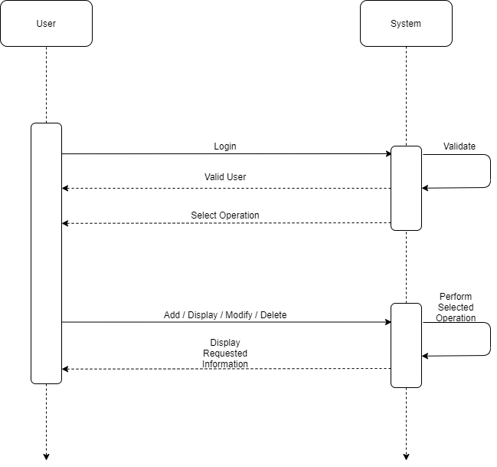
Sequence Diagram

Slide 9
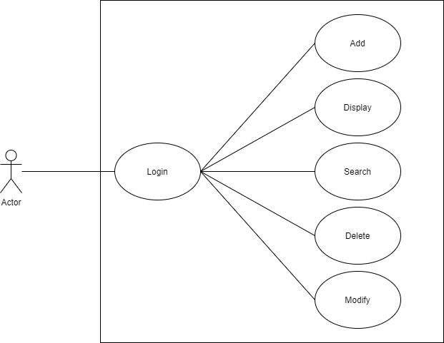
Use Case Diagram

Slide 10
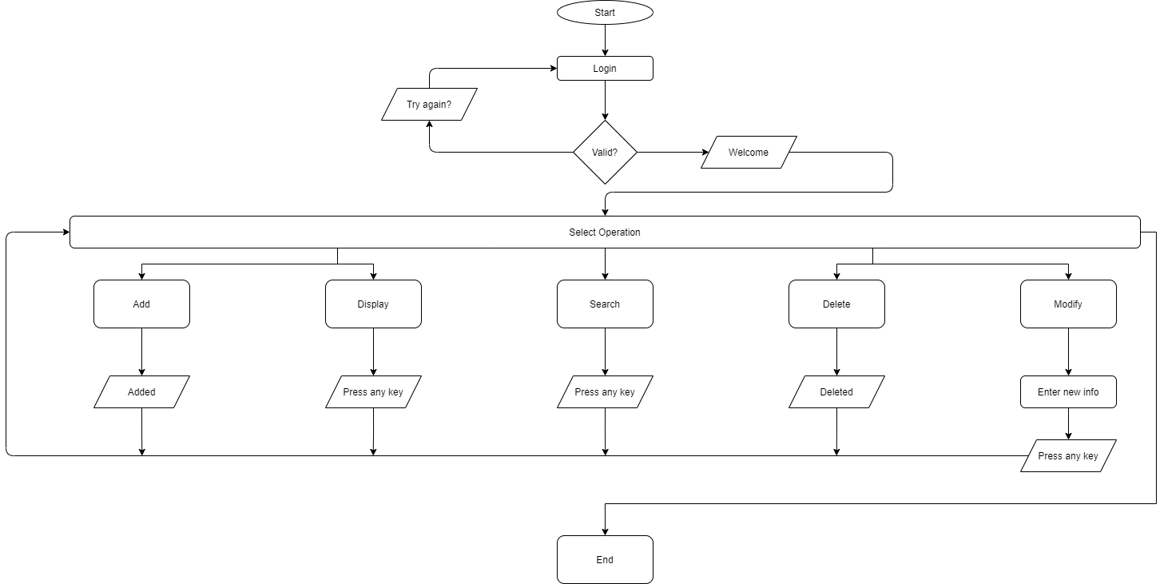
Activity Diagram

Slide 11
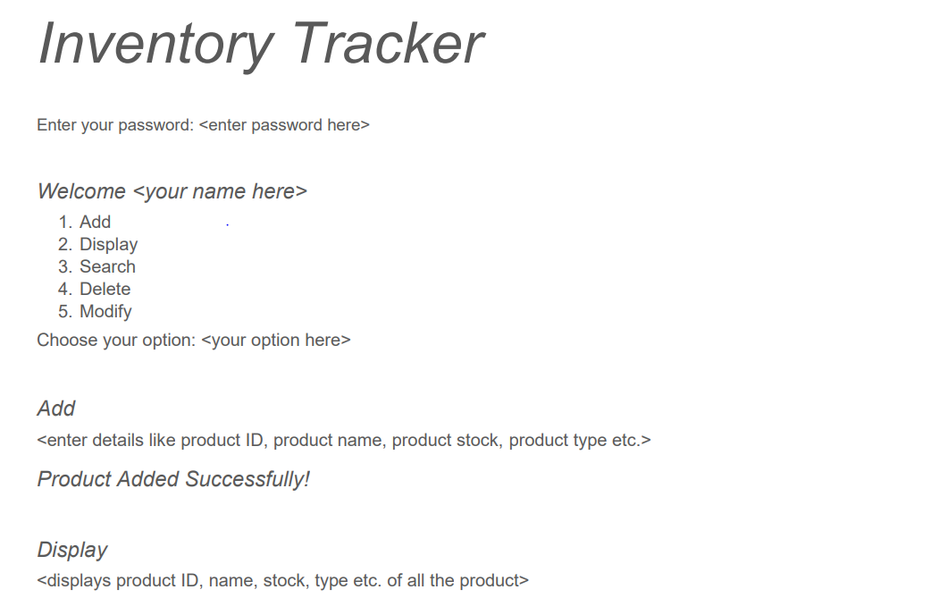
Output Model

Slide 12
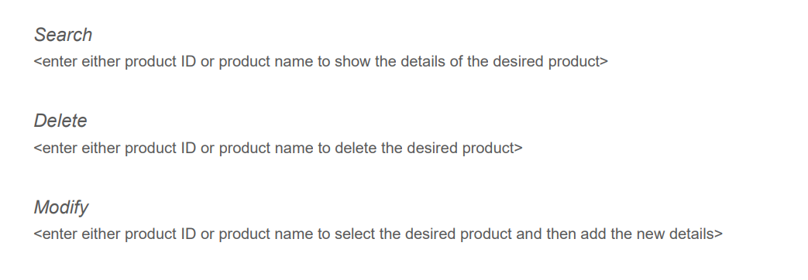

Slide 13
Future Enhancement
We could make a GUI for this.
We can also make a web app for this and host it on a server for commercial use.
We can also add billing system.

Slide 14
Conclusion
Overall, this is just a basic implementation of an inventory tracking program.
This is helpful in maintaining the inventory in a simpler way.
The code used in the program is robust and understandable which helps the user to execute and retrieve the required records with ease.

Slide 15
Thank you!
References:
GitHub repos for code reference
Diagrams.net for the system architecture diagrams

